Slide 1
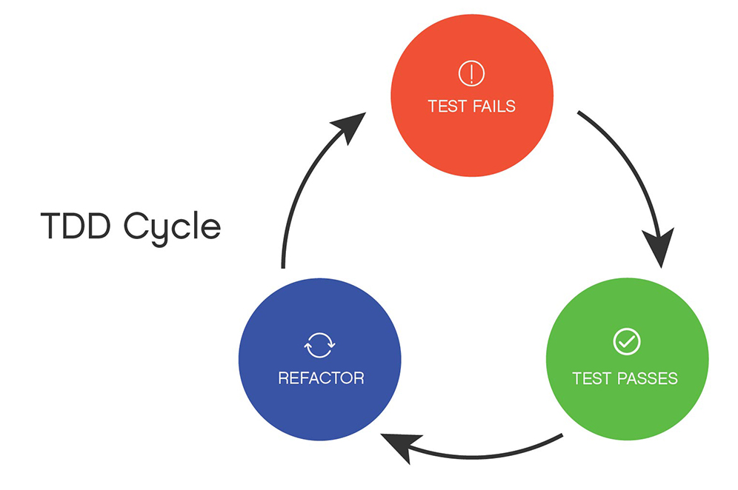
Test-Driven-Development
(TDD)
Fail - Pass - Refactor

Slide 2
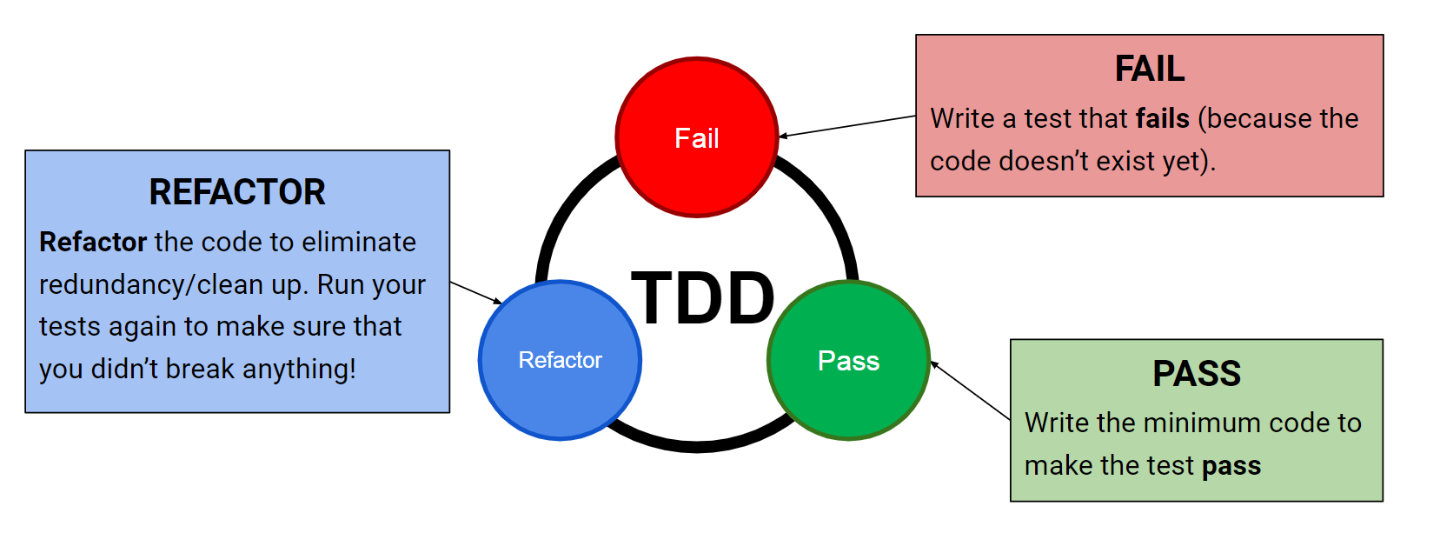
Test Driven Development

Slide 3
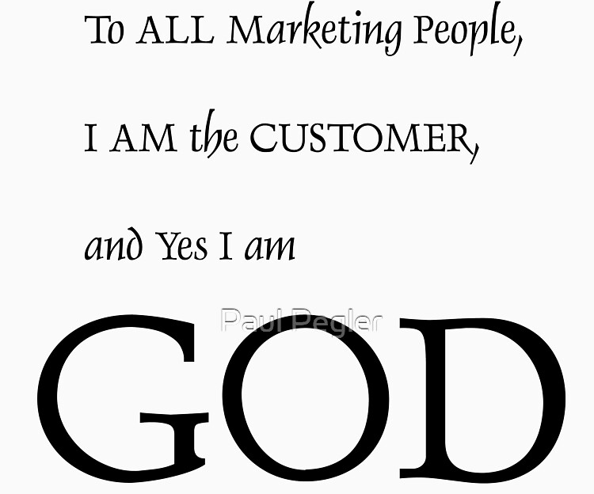
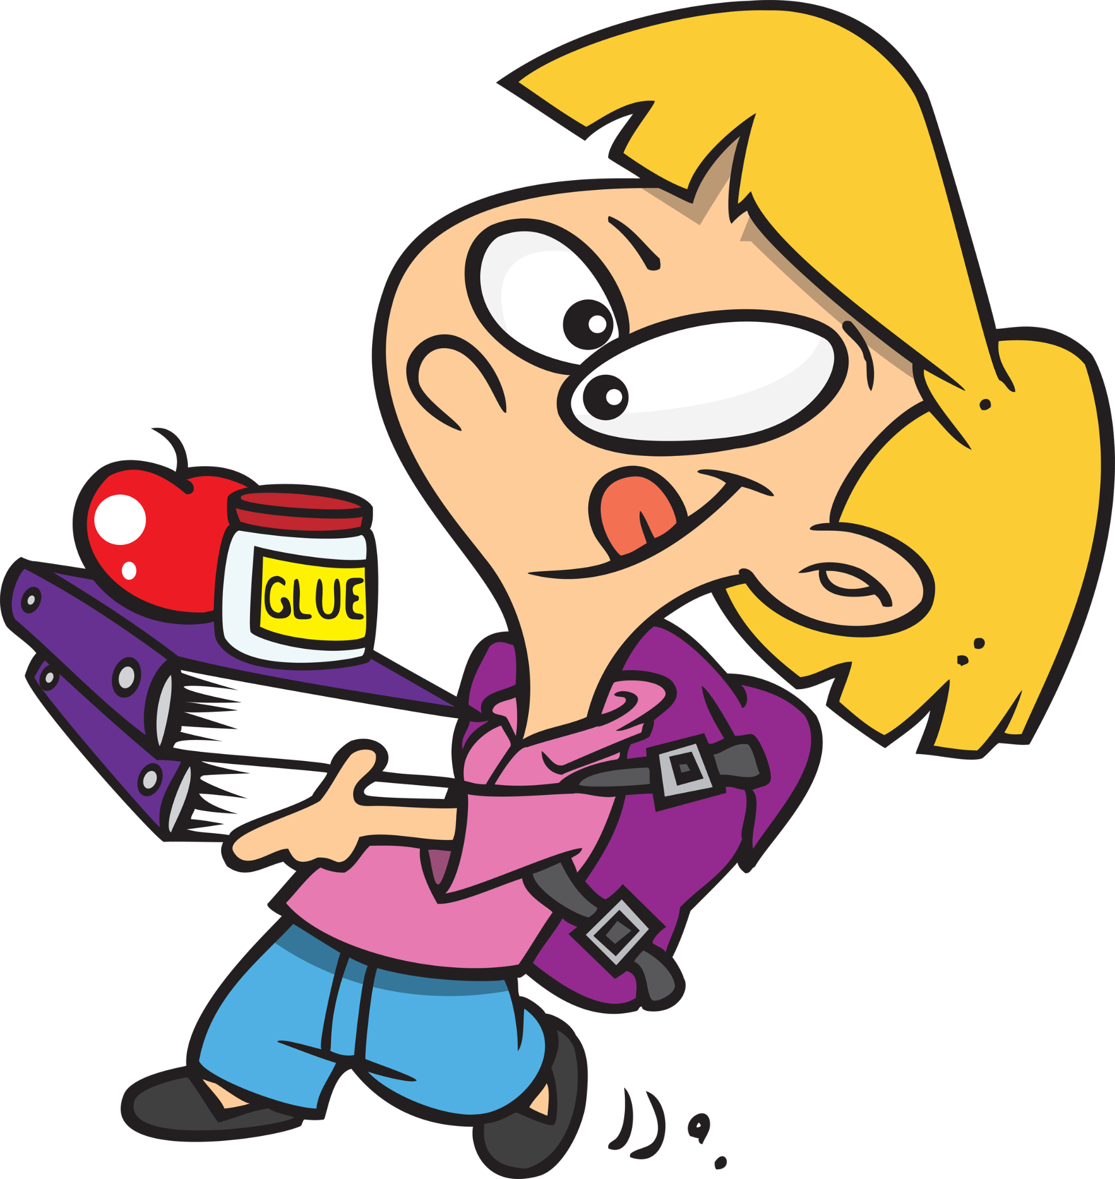
Customer’s Order (activity)
BJ. said that he hates doing his grade 1 math homework
He wants a calculator that calculates the answer for him.
He've only learned addition and subtraction.
“If I say "5 + 2", you should give me 7”
“If I say "8 - 3", you should give me 5”
Bean J.
Grade 1
MIT elementary school
He will pay $0.25 for this project

Slide 4
Lets work together
Practice
SteveWufeng/Calculator-Test_Driven_Development: Practice Test Driven Development (github.com)
https://github.com/SteveWufeng/Calculator-Test_Driven_Development

Slide 5
Customer’s Order Continue. (activity)
BJ. said that he is now doing multiplication and division.
He wants those new features to also be in the calculator
And he did not learn decimal yet.
New order:
“If I say "5 * 2", you should give me 10”
“If I say "9 / 3", you should give me 3”
Bean J.
Grade 2
MIT elementary school

Slide 6
Customer’s Order Continue. (activity)
BJ. said that he is now better at addition and subtraction he doesn’t want that feature anymore.
But he is afraid that he will need modulation and exponents.
New order:
“I don’t want addition and subtraction anymore”
“If I say "5 ^ 2", you should give me 25”
“If I say "9 % 3", you should give me 0”
Bean J.
Grade 2
MIT elementary school

Slide 7

Customer’s Order Continue. (activity)
BJ. he now has learned and mastered how to program himself.
He canceled the order and did not pay $0.25 to us.
New order:
Uhhh…..
🤡🤡🤡🤡🤡🤡
Bean J.
Grade 2
MIT Doctorate Study
We can maintain and optimize the code now and remove repeating code.

Slide 8
Why do we have to to TDD?

Slide 9
Why do we have to to TDD?
IDK…
Some companies use it some don’t

Slide 10
I personally think it a good skill to have.
Imagine you are a new member joining this project, You don’t know much about what the customer wants but you know there are some failed Unit Tests written by a dropped out member for this project. You are able to resume his progress even though you don’t know much about the project.

